Slide 1
HD Supplies Holdings
Leading Suppliers of Maintenance, Repairs and Operational Products
Proposed Acquisitions by KKR
Dated- October 2025

Slide 2
Transaction Overview
Metric | Values
Target | HD Supplies
Transaction Type | Leverage Buyout
Enterprise Value | $8.2 bn
LTM EBITDA | $835 m
Entry Multiple | 7.8
Debt / Equity | 72% / 28%
Equity Invested | $2.3 bn
Holding period | 5 years
Base-Case IRR | 19-20%
Base- Case MOIC | 2.4 x
IRR and MOIC based on base-case operating assumptions and a 7.5x exit EV/EBITDA multiple.

Slide 3
Business Overview
End Market | % of Revenue
Multifamily Housing | 45%
Hospitality | 20%
Healthcare | 20%
Other | 15%
HD Supply is a leading North American distributor of non-discretionary MRO products serving multifamily, hospitality, healthcare, and institutional end markets. The company benefits from recurring demand, a diversified customer base, and a scaled distribution network enabling strong free cash flow generation.

Slide 4
Industry and Market Positions
Highly fragmented MRO distribution landscape
Recurring, non-discretionary maintenance spend
High switching costs driven by service quality and logistics integration.
Metric | Commentary
Market Structure | Fragmented
Pricing Power | Moderate
Customer Switching | HIgh
Demand Cyclicality | Low- Moderate
Industry characteristics based on sponsor diligence.

Slide 5
Investment Thesis
Value Lever | How KKR Makes Money
Defensive Cash Flows | Non-discretionary MRO spend provides downside protection
EBITDA Growth | SKU expansion, pricing optimization, private label mix
Margin Expansion | Procurement scale, logistics efficiency, automation
Deleveraging | Strong FCF enables rapid senior debt paydown
No reliance on multiple expansion assumed in base case.

Slide 6
Sources and Uses
Uses | Amount ($mm)
Purchase Equity Value | 7950
Transaction Fees | 250
Total Uses | 8200
Sources | Amount ($mm)
Term Loan B | 4800
Asset Backed Debt | 1100
Total Debt | 5900
Sponsor equity | 2300
Total Sources | 8200
Sources equal uses at close; excludes refinancing of existing facilities.

Slide 7
Capital Structure
Metric | Values
Enterprise Value | 8200
Total Debt | 5900
Equity | 2300
Debt / EV | 72%
Equity / EV | 28%
Net leverage of approximately 7.1x at entry reflects conservative underwriting for an industrial distribution business, with rapid deleveraging driven by strong free cash flow.
Leverage reflects conservative underwriting for an industrial distribution business.

Slide 8
Operating Projections
Metric | LTM | Year 1 | Year 2 | Year 3 | Year 4 | Year 5
Revenue | 7750 | 7944 | 8182 | 8468 | 8722 | 8940
EBITDA | 835 | 890 | 949 | 1016 | 1073 | 1118
EBITDA M. | 10.8% | 11.2% | 11.6% | 12.0% | 12.3% | 12.5%
Projections reflect base-case operating assumptions.

Slide 9
Debt Repayment
Metric ($mm) | Entry | Y3 | Y5
Total Debt | 5900 | 4175 | 2854
Net Debt / EBITDA | 7.1 x | 4.1 x | 2.6 x
Assumes 100% excess cash sweep to senior debt.

Slide 10
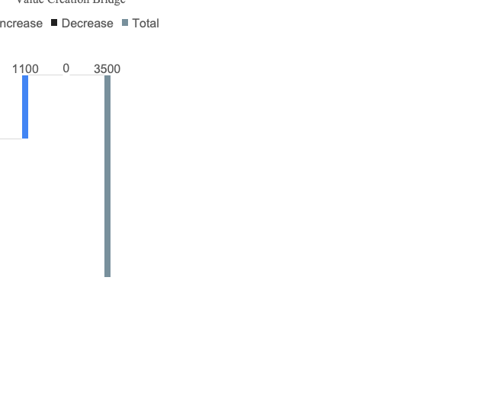
Exit & Returns
Metric | Value
Exit EBITDA | 1118
Exit Multiple | 7.5
Exit Enterprise Value | 8385
Net Debt at Exit | 2854
Equity Value | 5531
Metric | Value
IRR | 19-20%
MOIC | 2.4 x
Exit multiple below entry; returns driven by deleveraging.

Slide 11
Sensitivity
Table 1 Exit Multiples vs IRR
Table 2 EBITDA Growth VS IRR
Exit EV/ EBITDA | 6.5 x | 7.0 x | 7.5 x | 8.0 x
IRR(%) | 15.5% | 17.5% | 19.5% | 22.0%
EBITDA Case | -10% | -5% | Base | +5%
IRR(%) | 15.5% | 17.5% | 19.5% | 22.0%
All other assumptions held constant.

Slide 12
Recommendations
Investment Recommendation
Stable, defensive MRO business with recurring demand
Strong free cash flow supports rapid deleveraging
Conservative underwriting with downside capital protection
Attractive risk-adjusted returns without reliance on multiple expansion
Subject to final confirmatory diligence and financing availability.

